Slide 1



Westland Sales Dashboard
View in Power BI
Daniel Okunade
Dec 2023

Slide 2
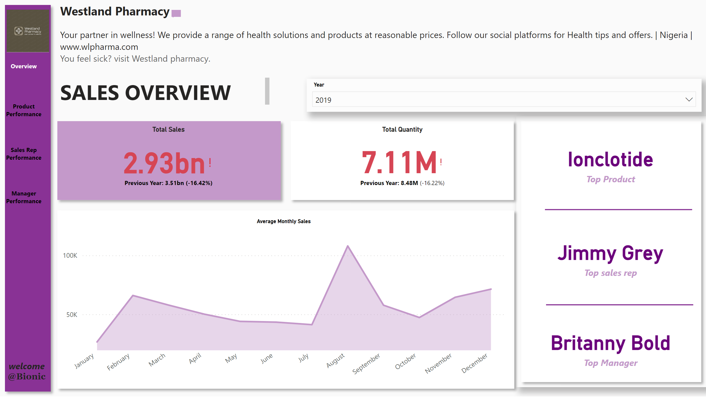
Overview
Notes:
image
No alt text provided
actionButton
No alt text provided
actionButton
No alt text provided
actionButton
No alt text provided
actionButton
No alt text provided
textbox
No alt text provided
textbox
No alt text provided
Average Monthly Sales
No alt text provided
Total Sales
No alt text provided
Total Quantity
No alt text provided
slicer
No alt text provided
card
No alt text provided
card
No alt text provided
card
No alt text provided
shape
No alt text provided
shape
No alt text provided
textbox
No alt text provided
shape
No alt text provided
shape
No alt text provided
shape
No alt text provided
shape
No alt text provided
shape
No alt text provided
shape
No alt text provided

Slide 3
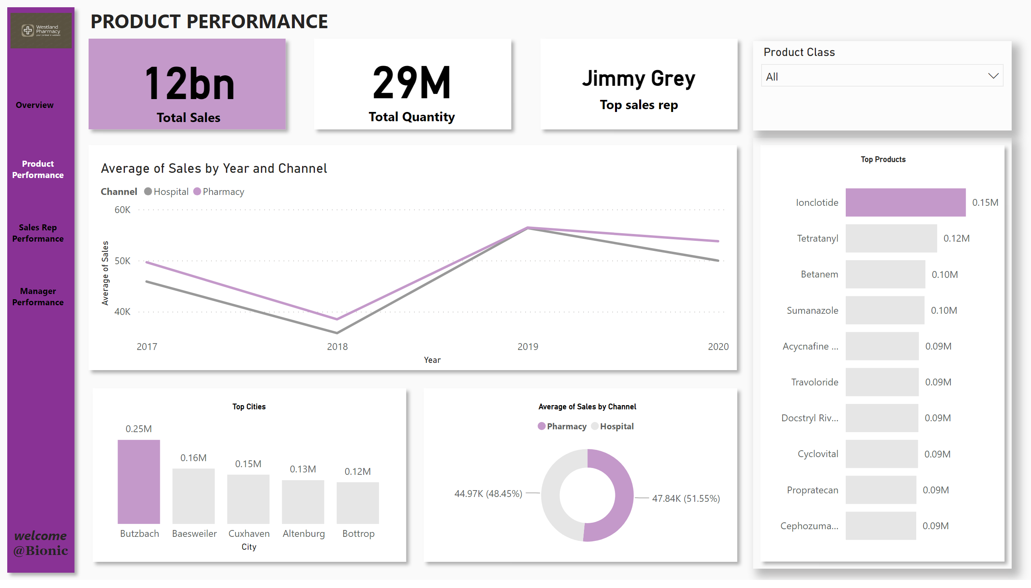
Product
Notes:
textbox
No alt text provided
lineChart
No alt text provided
Top Products
No alt text provided
Top Cities
No alt text provided
card
No alt text provided
card
No alt text provided
card
No alt text provided
donutChart
No alt text provided
image
No alt text provided
actionButton
No alt text provided
actionButton
No alt text provided
actionButton
No alt text provided
actionButton
No alt text provided
textbox
No alt text provided
shape
No alt text provided
slicer
No alt text provided
shape
No alt text provided
shape
No alt text provided
shape
No alt text provided
shape
No alt text provided
shape
No alt text provided
shape
No alt text provided
shape
No alt text provided

Slide 4
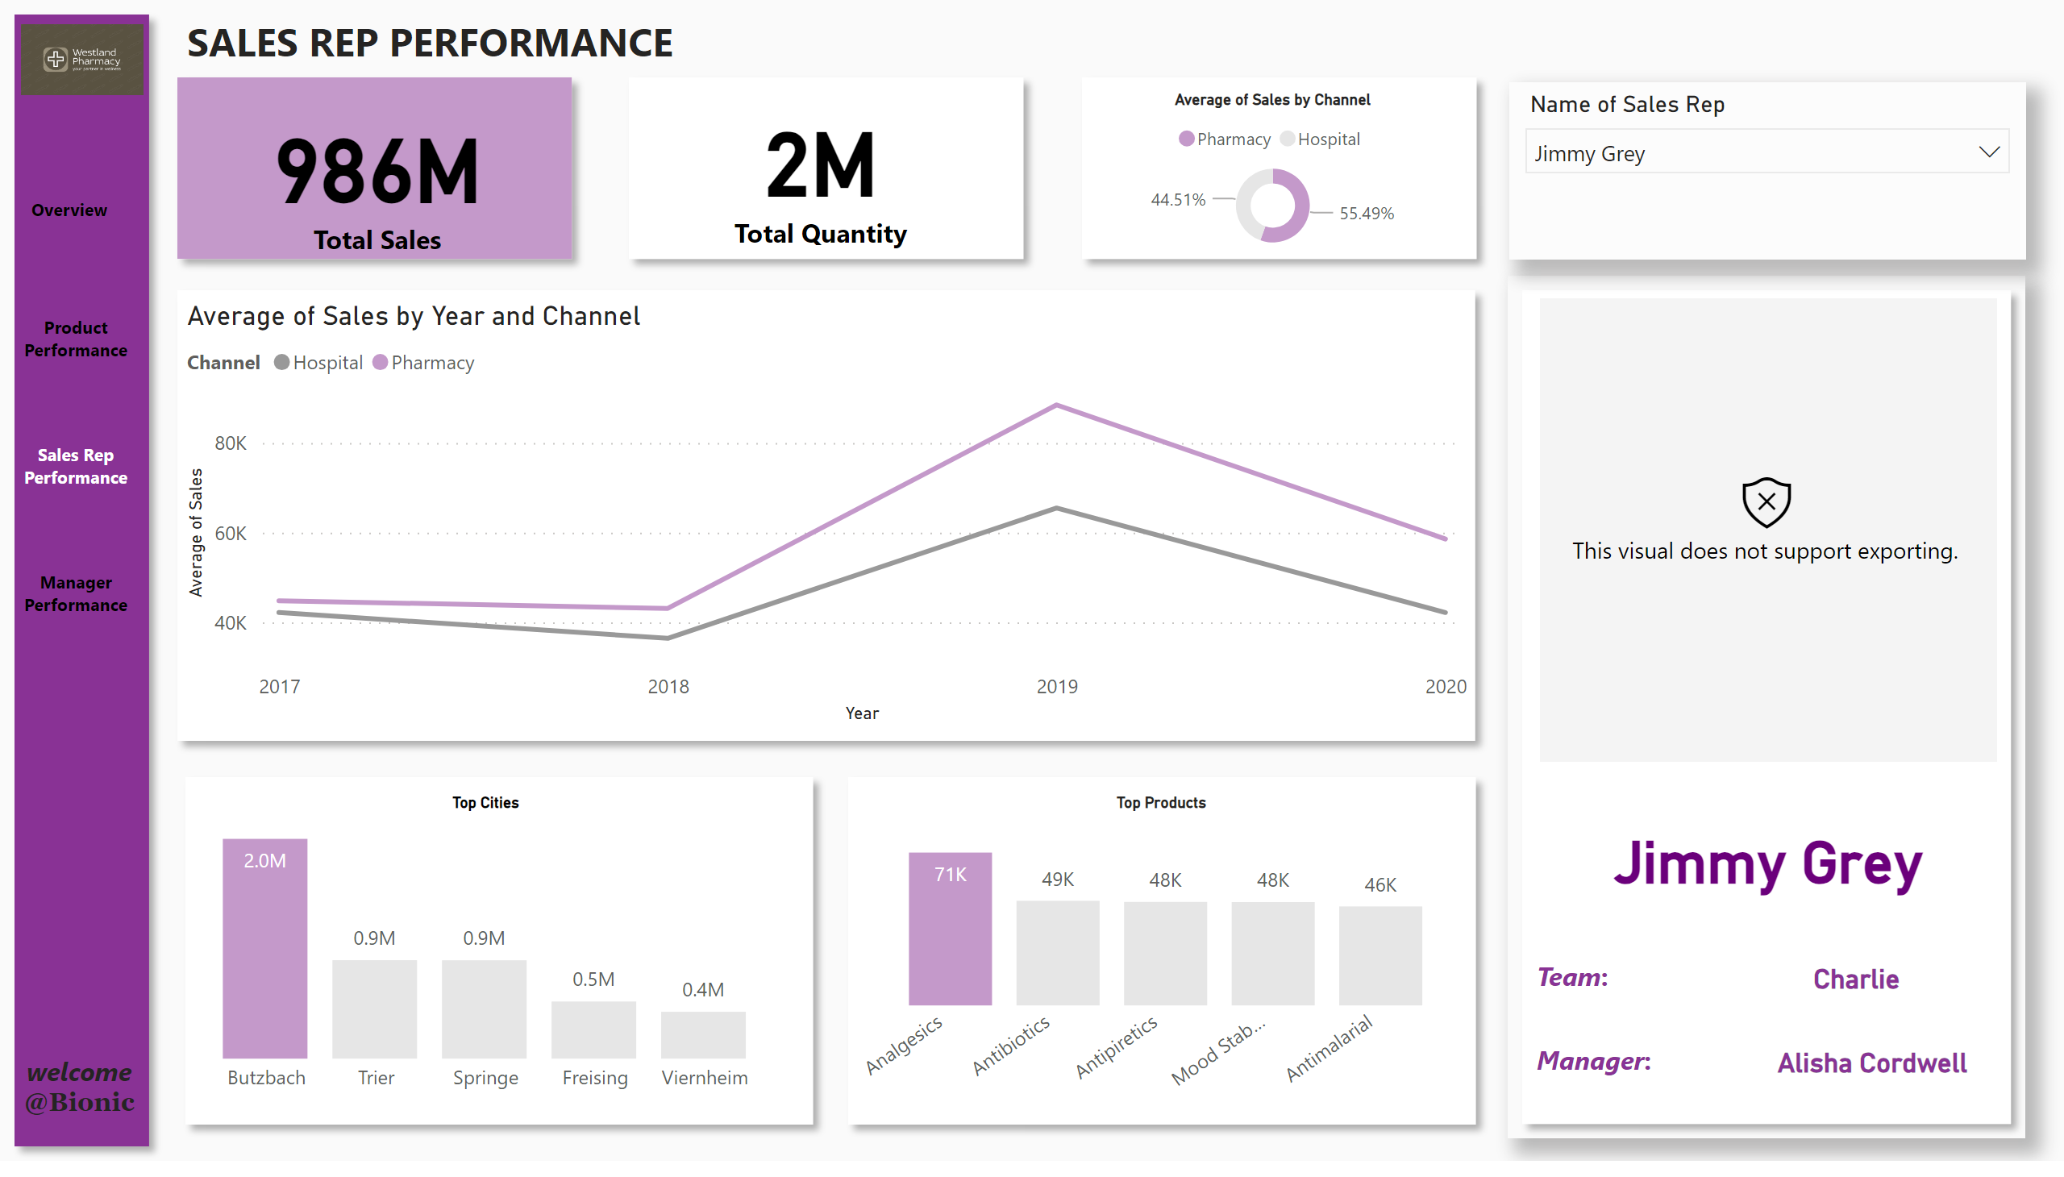
Sales person
Notes:
shape
No alt text provided
textbox
No alt text provided
card
No alt text provided
card
No alt text provided
lineChart
No alt text provided
Top Cities
No alt text provided
Top Products
No alt text provided
donutChart
No alt text provided
image
No alt text provided
actionButton
No alt text provided
actionButton
No alt text provided
actionButton
No alt text provided
actionButton
No alt text provided
textbox
No alt text provided
card
No alt text provided
card
No alt text provided
simpleImageEBC4593F96F1425FB3D84C5BF02B5075
No alt text provided
shape
No alt text provided
slicer
No alt text provided
textbox
No alt text provided
textbox
No alt text provided
shape
No alt text provided
shape
No alt text provided
shape
No alt text provided
shape
No alt text provided
shape
No alt text provided
card
No alt text provided
shape
No alt text provided

Slide 5
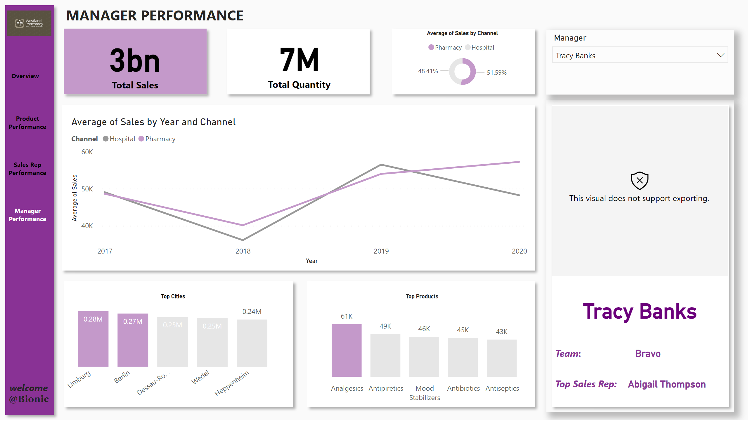
Manager
Notes:
shape
No alt text provided
textbox
No alt text provided
slicer
No alt text provided
shape
No alt text provided
shape
No alt text provided
lineChart
No alt text provided
shape
No alt text provided
Top Products
No alt text provided
shape
No alt text provided
Top Cities
No alt text provided
shape
No alt text provided
card
No alt text provided
shape
No alt text provided
card
No alt text provided
shape
No alt text provided
card
No alt text provided
image
No alt text provided
actionButton
No alt text provided
actionButton
No alt text provided
actionButton
No alt text provided
actionButton
No alt text provided
textbox
No alt text provided
card
No alt text provided
textbox
No alt text provided
textbox
No alt text provided
donutChart
No alt text provided
simpleImageEBC4593F96F1425FB3D84C5BF02B5075
No alt text provided
card
No alt text provided

